Slide 1
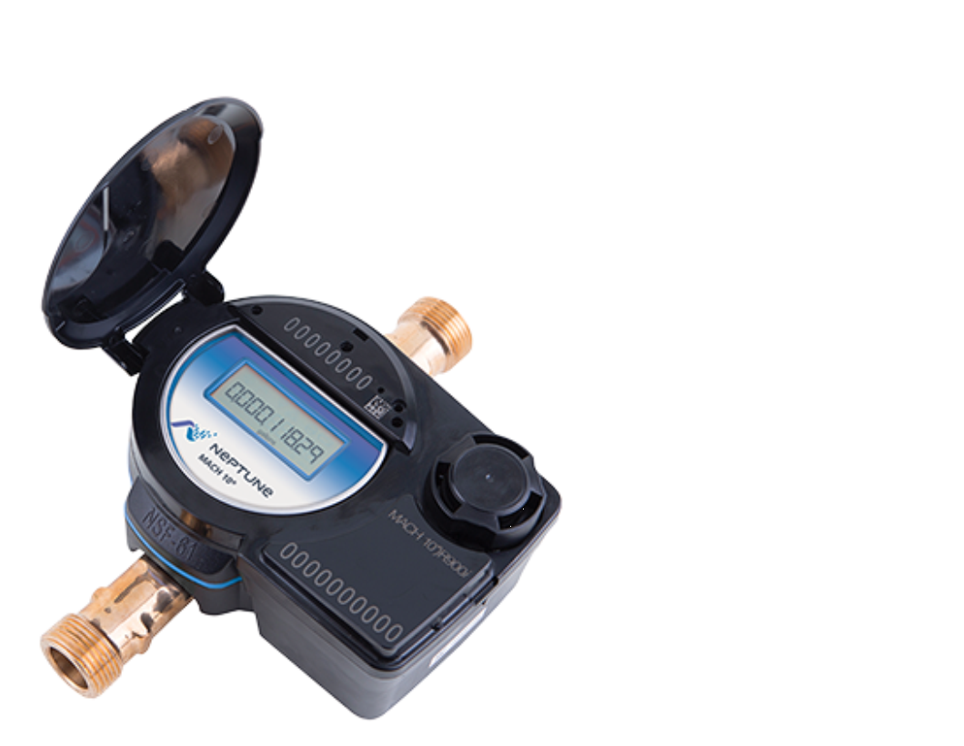

UTILITY SOLUTIONS
METER AND AUTOMATION

Slide 2
Water Meters &
Reading Technology

Slide 3
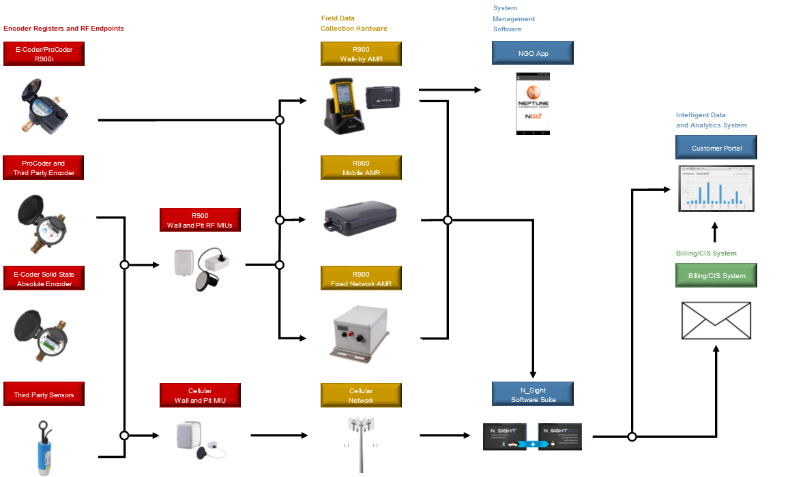


Slide 4
Water Meters

Slide 5
Water Meters
Positive Displacement
Static
Turbine
Compound
Fire Serivce
Hydrant

Slide 6

Positive Displacement Meter

Slide 7
Positive Displacement
Mechanical Meter
Meter displaces a certain amount of volume per magnet revolution
Volumetric measurement

Slide 8
Positive Displacement
Advantages
  Excellent low flow accuracy
  Not affected by upstream flow disturbances
Disadvantages
  Limited in high flow rates by pressure losses
  Limited in size by forces on ball and disc

Slide 9
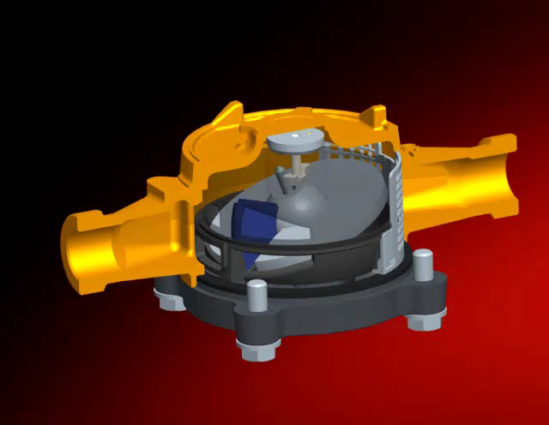
Positive Displacement

Slide 10
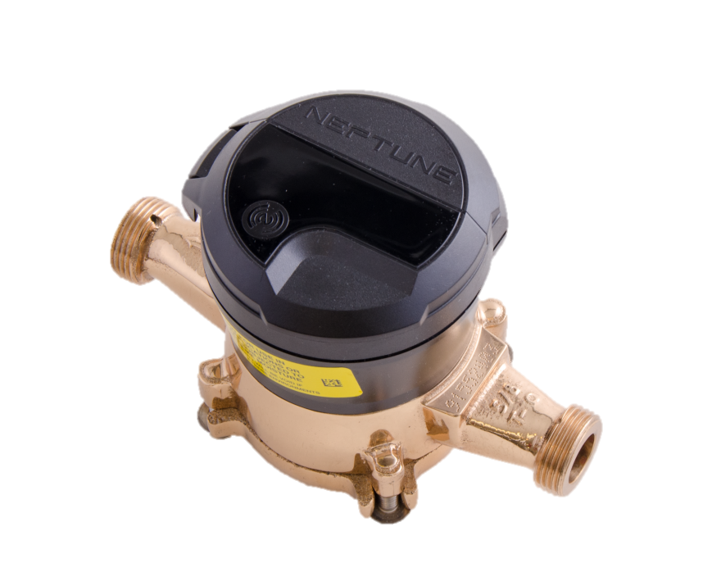
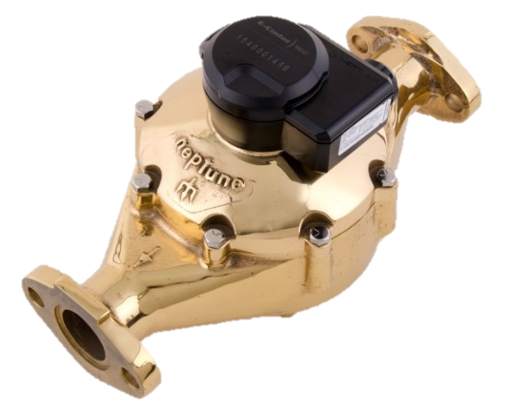
T-10 Meter
Applications
  Residential and “light commercial”
  Where small groups of people live and work
Nutating Disc Measuring Chamber
  Sustained long-term accuracy
  Quiet operation: meters in basements
  Allows debris to pass more freely
NSF/ANSI 61, Annexes F & G Approved
  “Green Meter” – manufactured with a lead free alloy

Slide 11
T-10 Meter
Excellent Low Flow
  1/8 gpm @ 95% accuracy
    AWWA standard is ¼ gpm
  Increased revenue and captured leaks
NSF/ANSI 61 Approved
  Lead free bronze foundry in Tallassee
  Exceeding Safe Drinking Water Regulations since 2001
  First to 100% convert

Slide 12
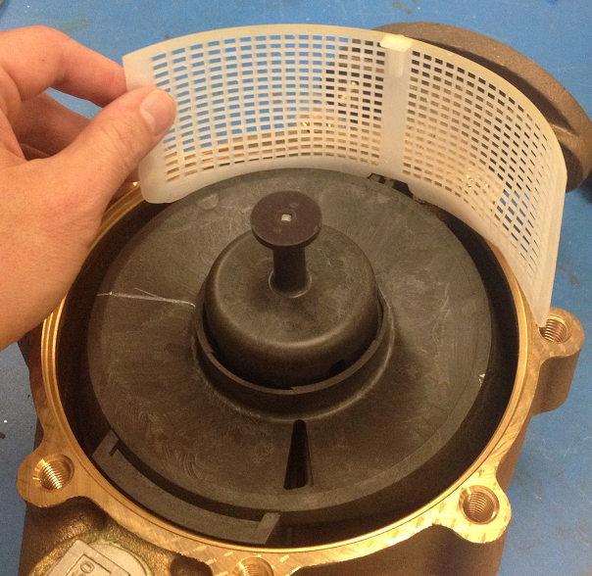
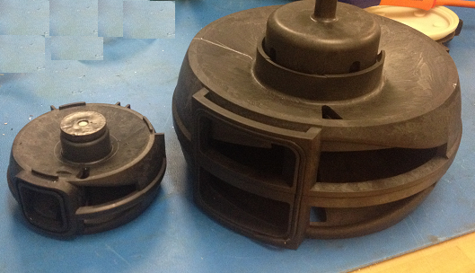
T-10 Meter
Strainer for debris
PD Chamber
Different sizes use same chamber technology

Slide 13
MACH 10 Ultrasonic Meter

Slide 14
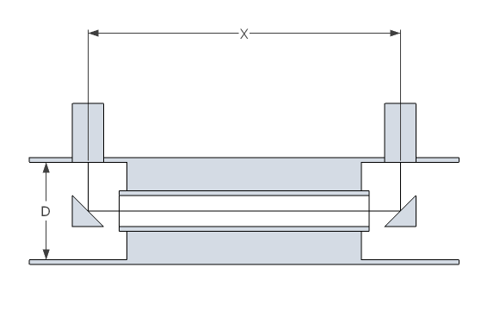
Basic Theory of Operation of Ultrasonic Meters
Transducer 1
Transducer 2
Flow
u

Slide 15
Basic Theory of Operation of Ultrasonic Meters
Ultrasonic signal WITH flow
t₁
Flow

Slide 16
Basic Theory of Operation of Ultrasonic Meters
Ultrasonic signal AGAINST flow
t₂
Flow

Slide 17
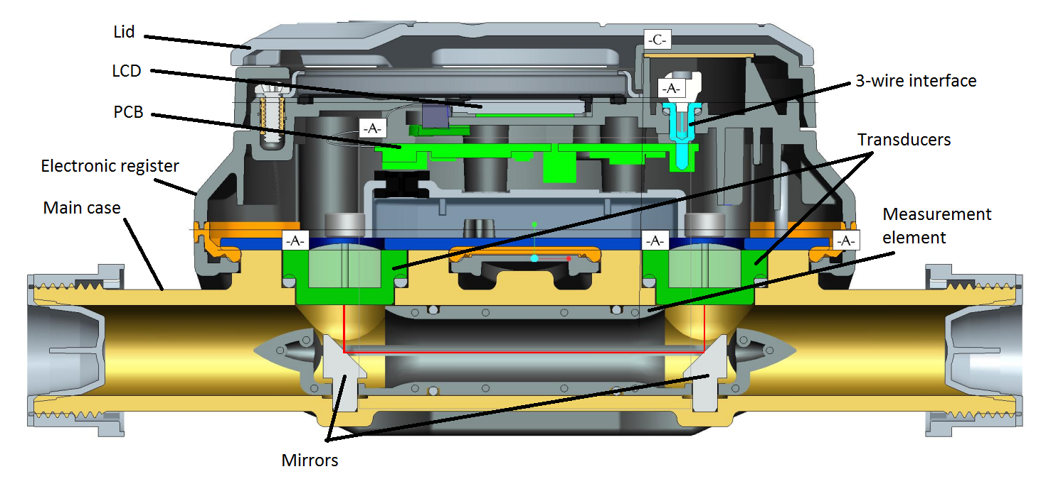
MACH 10 Ultrasonic Meter Technology

Slide 18
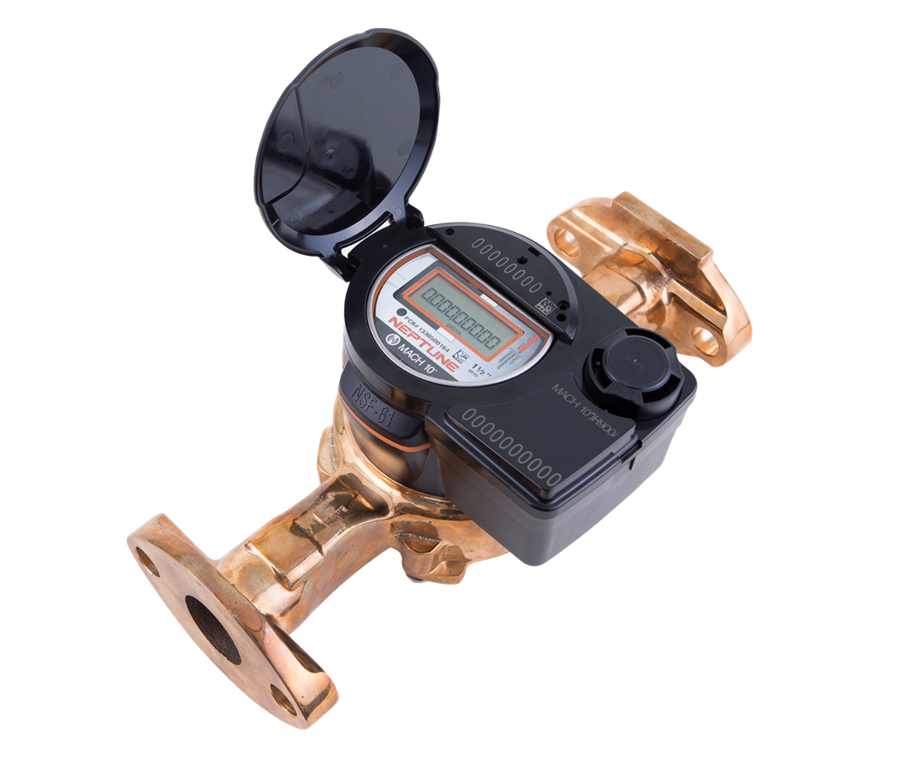
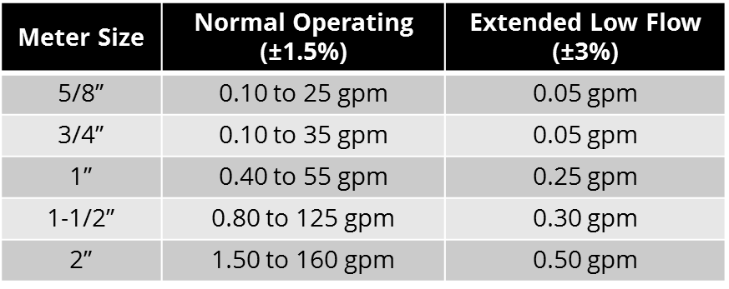
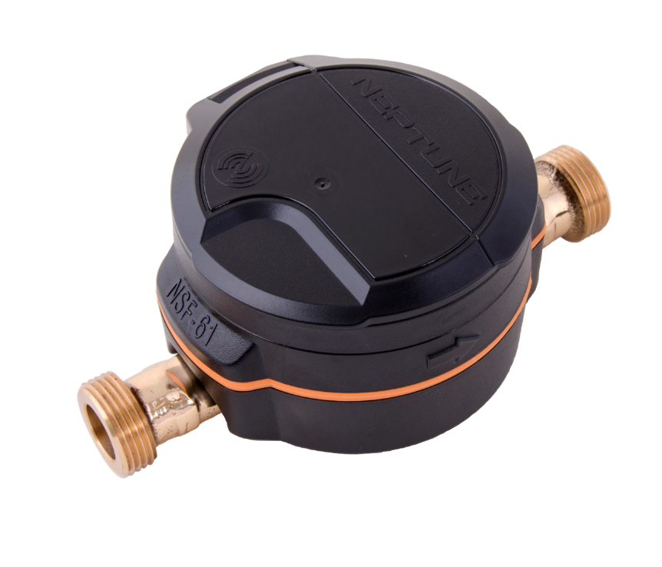
MACH 10 Meter
Neptune developed technology
Extended flow range / extended low flow
Lifetime meter accuracy
Lead free bronze maincase with lifetime warranty
IP68-rated assembly
  Fully potted electronics with tempered glass lens

Slide 19
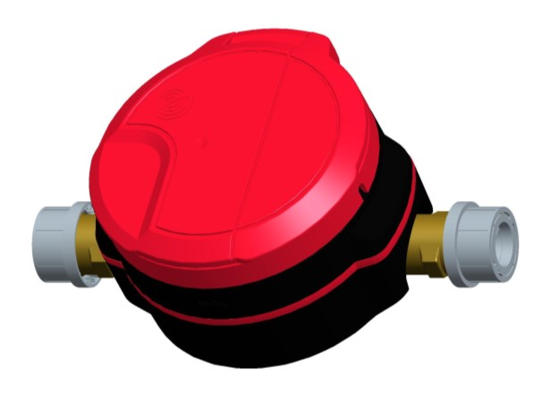

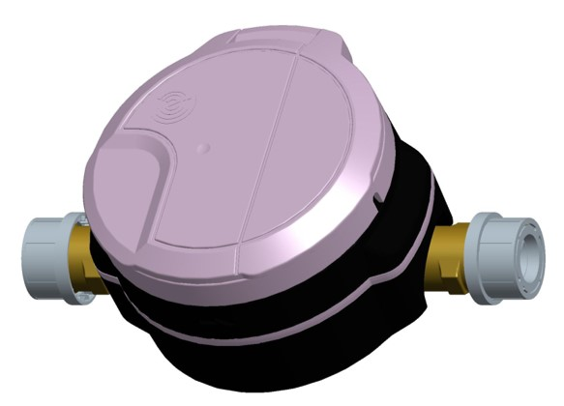
Additional Applications
Fire Service Applications
  UL 327B Certification
  Availability: 3/4” – 1”
  Units will be built with RED lid and gasket
Reclaim Water
  Availability: 5/8” – 2”
  Units will be built with LAVENDER lid and gasket

Slide 20
MACH 10 Solutions – Take Control
Monitoring solutions, which use E-CODER® protocol, include:
  Leak detection
  Reverse flow detection
  Flow indicator
  Empty pipe
  Low battery

Slide 21
MACH 10 Lifetime Accuracy Performance

Slide 22
HP Turbine

Slide 23
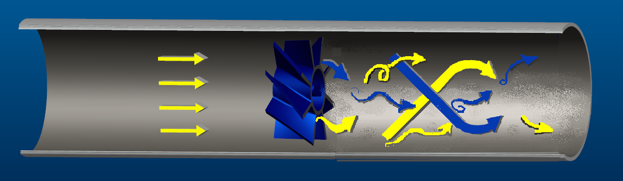
Turbine Technology
Product lines using a turbine:
HP Turbine
TRU/FLO
HP Fire Service Turbine
HP PROTECTUS III
Fire Hydrant Meter
The flow must be conditioned:
No strainer: 8-10 diameters straight pipe upstream
Strainer: 4-6 diameters straight pipe upstream

Slide 24
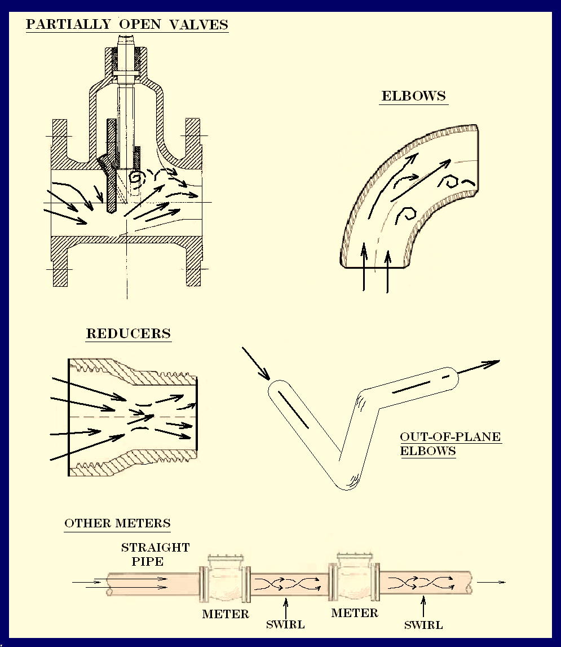
What Causes Irregular Flows
Generally, any abrupt change in the plumbing is a potential source of flow irregularities

Slide 25
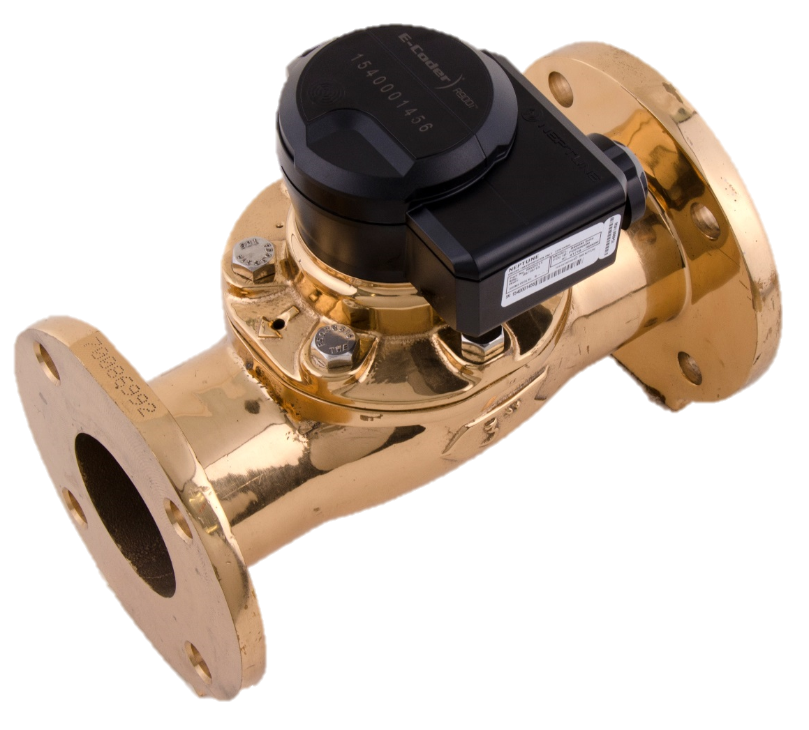
HP Turbine
Clean water applications
Cold water measurement
Turbine Rotor is used to measure the velocity
Rotor is magnetically coupled to the register
HP Turbine Features
Hydrodynamically balanced rotor
  Minimizes wear
Calibration vane for small adjustments if needed

Slide 26
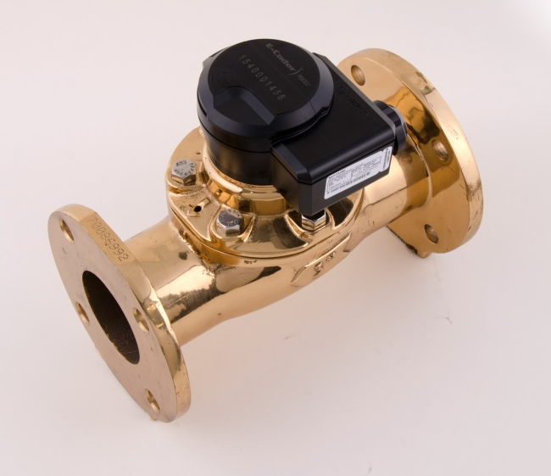
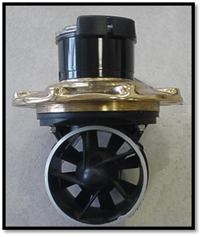
HP Turbines 1 ½” – 10”
Moderate to High Flow Rates
    4-6500 GPM
Accuracy to within +/- 1.5%
    Accuracy calibration vane
Full line is bronze body
    NSF/ANSI 61 approved
    Lead free alloy

Slide 27
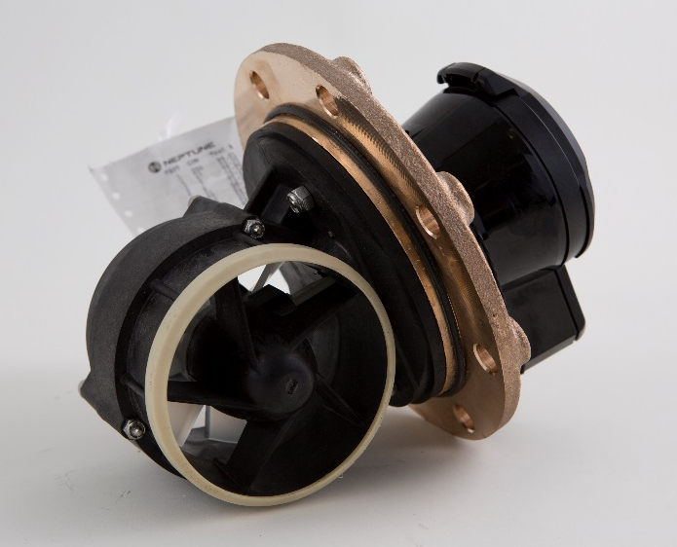
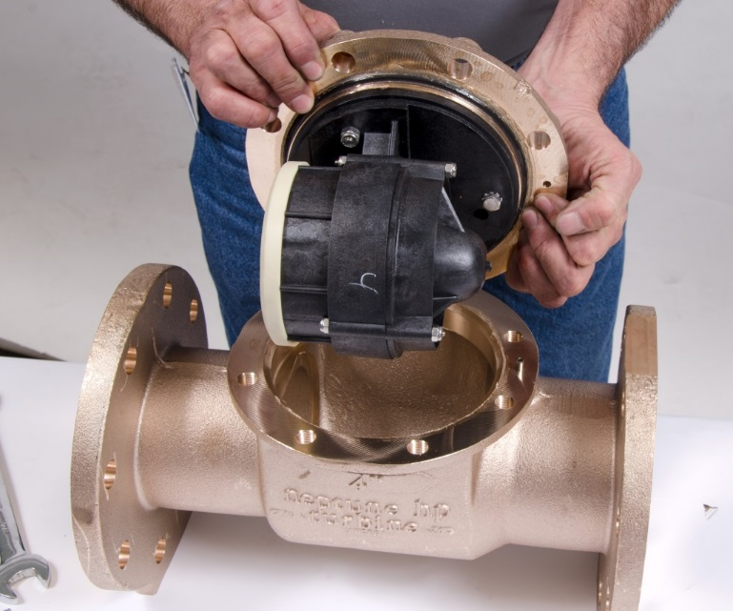
Unitized Measuring Element (UME)
Measuring Element
New Register
Factory Test Ticket

Slide 28
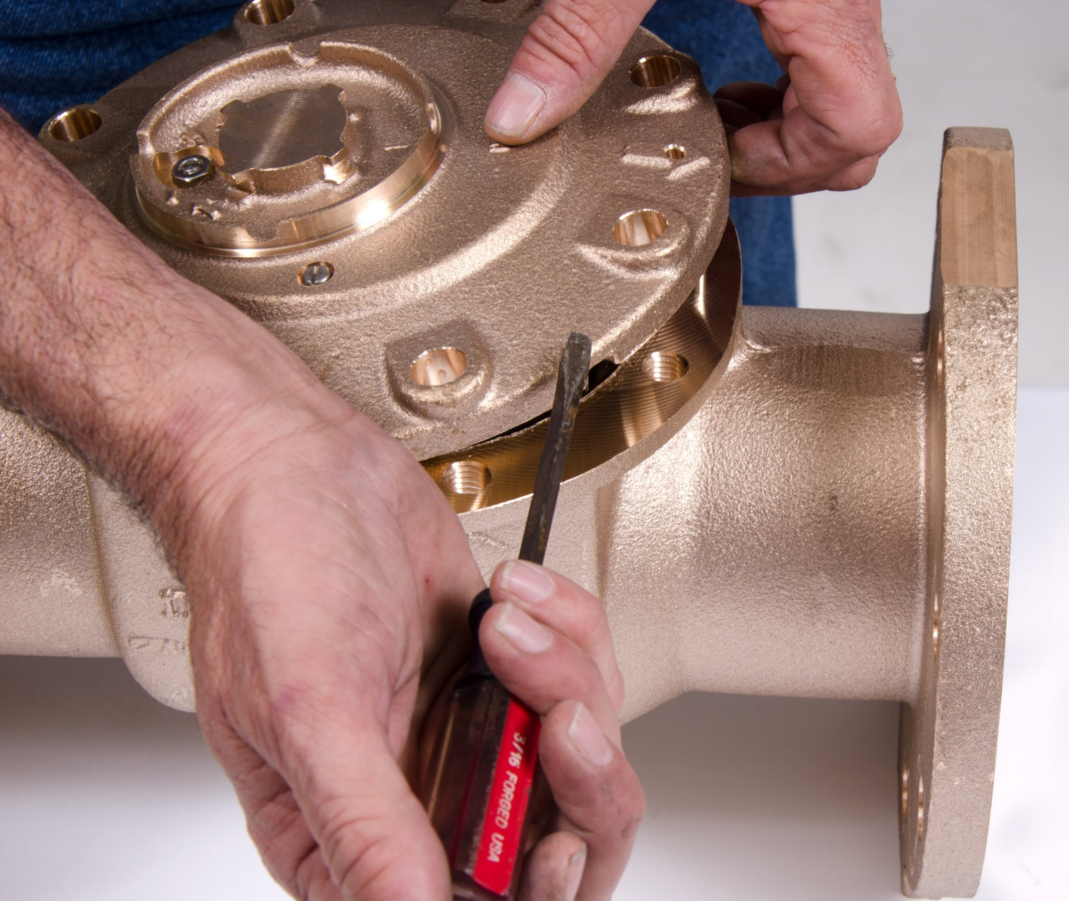
UME Change Out

Slide 29
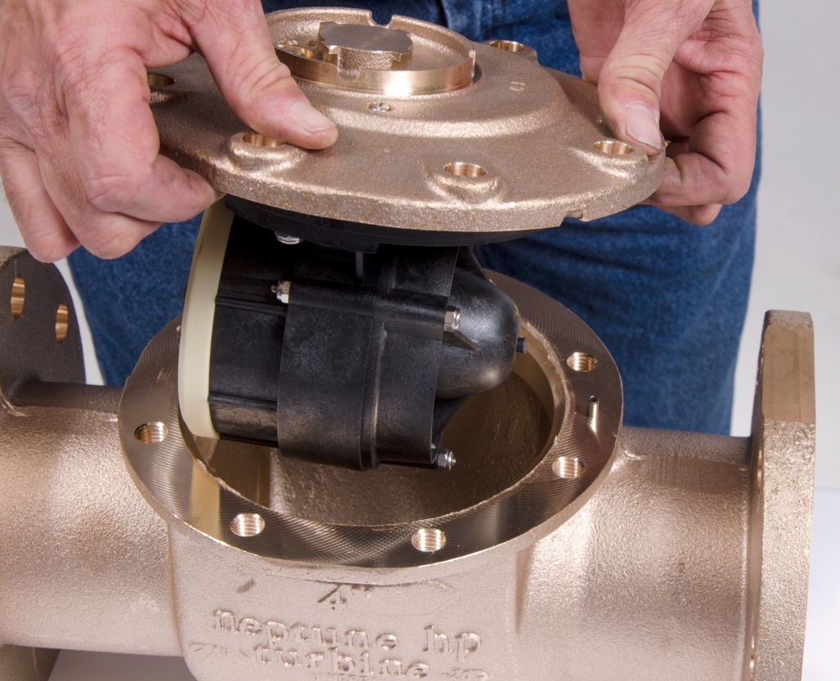
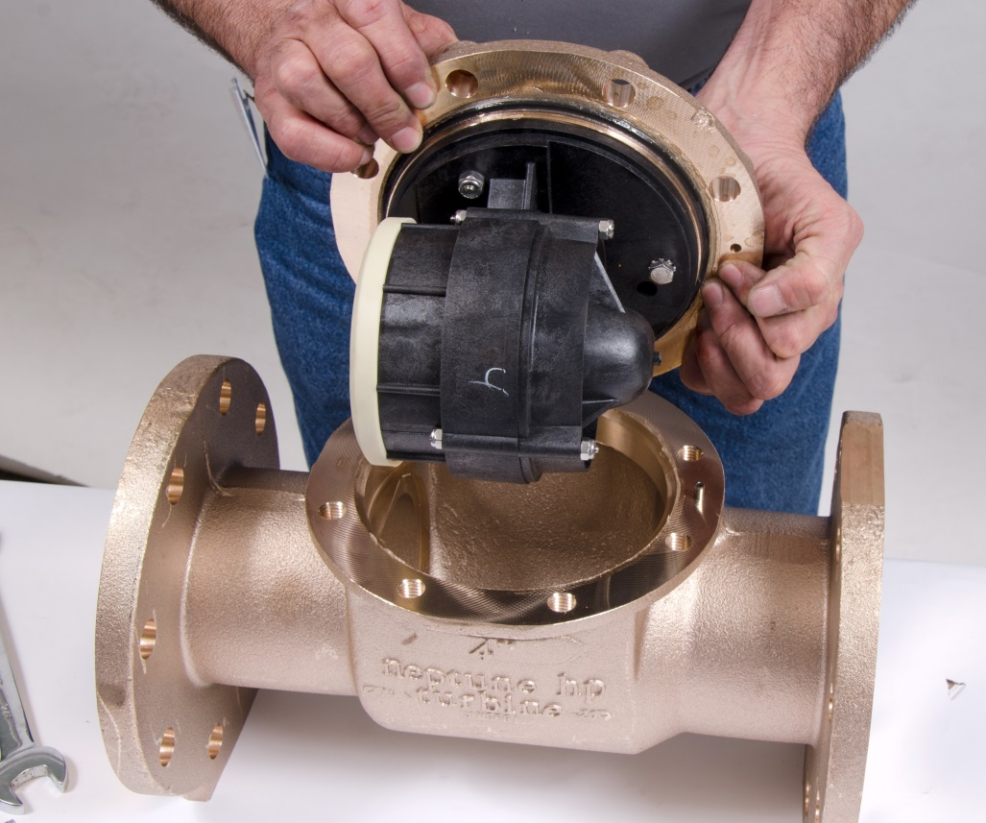
UME Change Out

Slide 30
TRU/FLO Compound Meter

Slide 31
TRU/FLO Compound Meter
What is it?
Two meters in one main case
  PD meter for low flow rates
  Turbine for moderate to high flows
Hydraulic Valve
  Transitions flow from PD meter to turbine and vice-versa
HP Turbine Features
  Measures low flows to high flows
  Easy UME change out
  Best turndown available

Slide 32
TRU/FLO® Compound 2” – 6”x8”
Moderate to High Flow Rates
  1/8-2000 GPM
Hydraulic Valve and Automatic Throttling Valve
  Minimizes crossover range & maximizes revenue
UME, Calibration Vane, & Test Port
  Ease of maintenance and ensures maximum revenue
Full line is bronze body
  NSF/ANSI 61 approved
  Lead free alloy

Slide 33
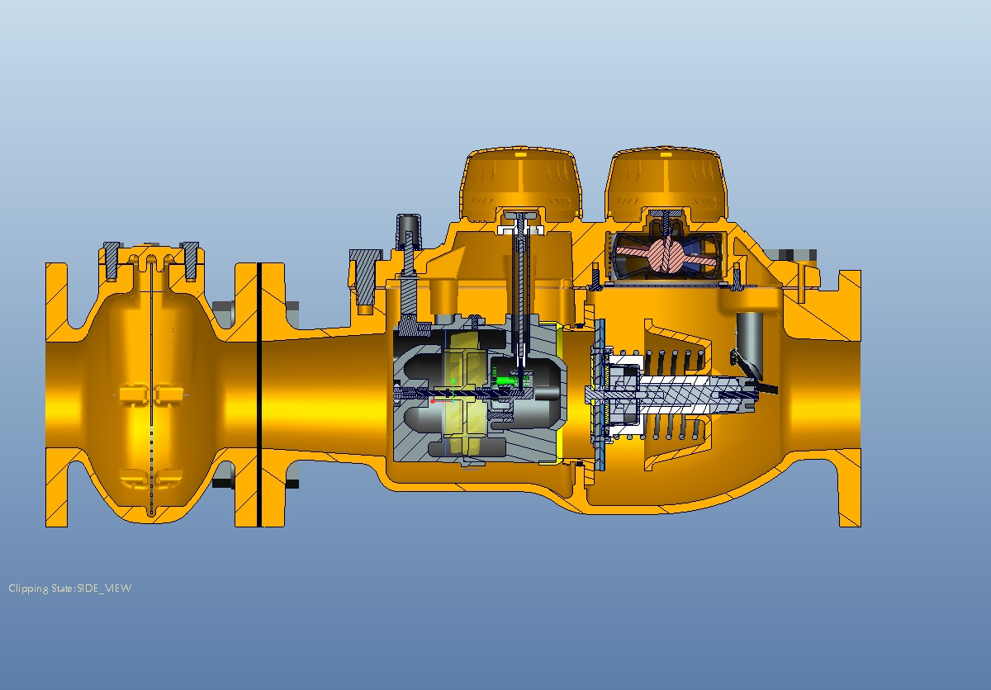
TRU/FLO with Strainer
T-10 Register
Turbine Register
Calibration Vane
Throttle Tube
Throttle Tube Door
Turbine Element
Valve Piston
Main Valve

Slide 34
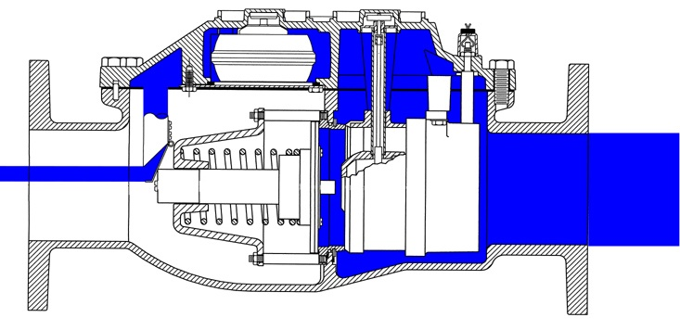
Low Flow

Slide 35
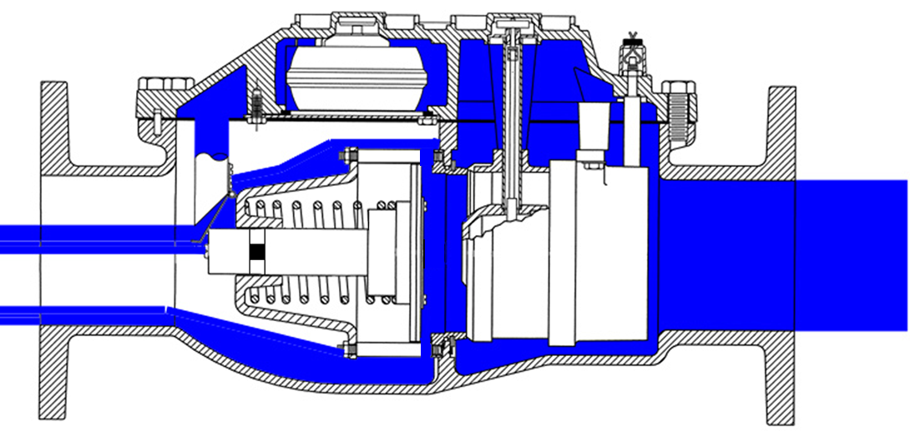
Crossover

Slide 36
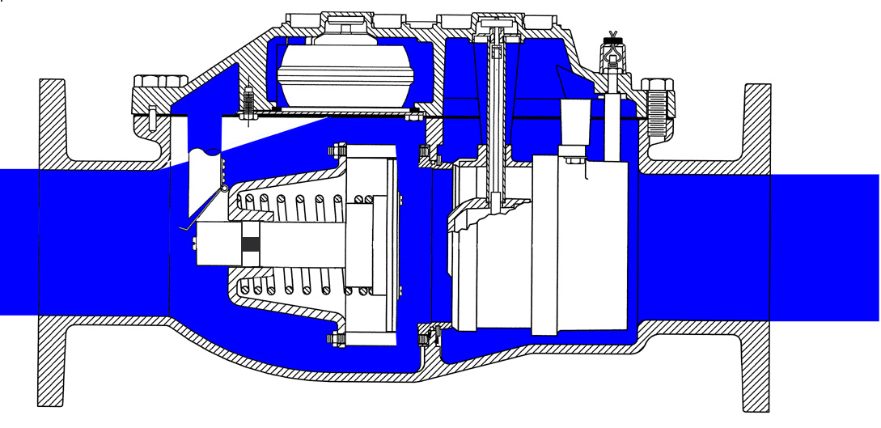
Intermediate and High Flow

Slide 37
Fire Service Meter Line

Slide 38
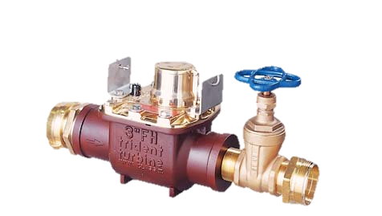
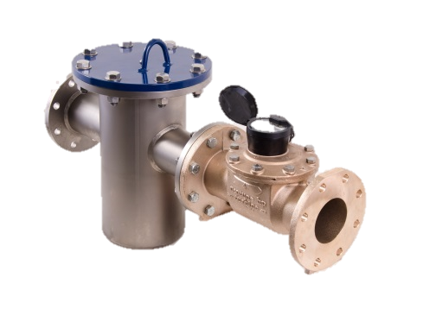
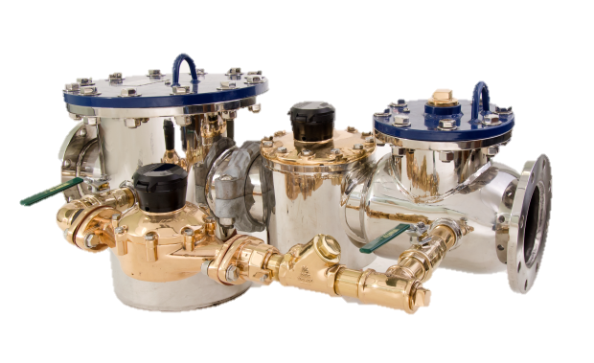
Fire Service Product Line
Fire Service HPT
HP PROTECTUS III S
Fire Hydrant

Slide 39
Fire Service HP Turbine
Fire Service Applications
3” – 10” Sizes
  5 – 6500 GPM
Uses Standard HP Turbine
  UL/FM Listed Basket Strainer
HP Turbine is bronze body
  NSF/ANSI 61 approved
  Lead free alloy

Slide 40
HP PROTECTUS® III Stainless Steel (S)
Fire Service Applications
NSF/ANSI 61
304 Stainless Steel
20 (10/10) year body warranty
Stainless Steel bolts
304 SS Covers (optional)
4” - 10” sizes / 3/8 to 6500 gpm
UL/FM Listed
Victaulic Coupling
Spring Loaded SS Valve
Automatic Throttle Valve
Test Ports

Slide 41
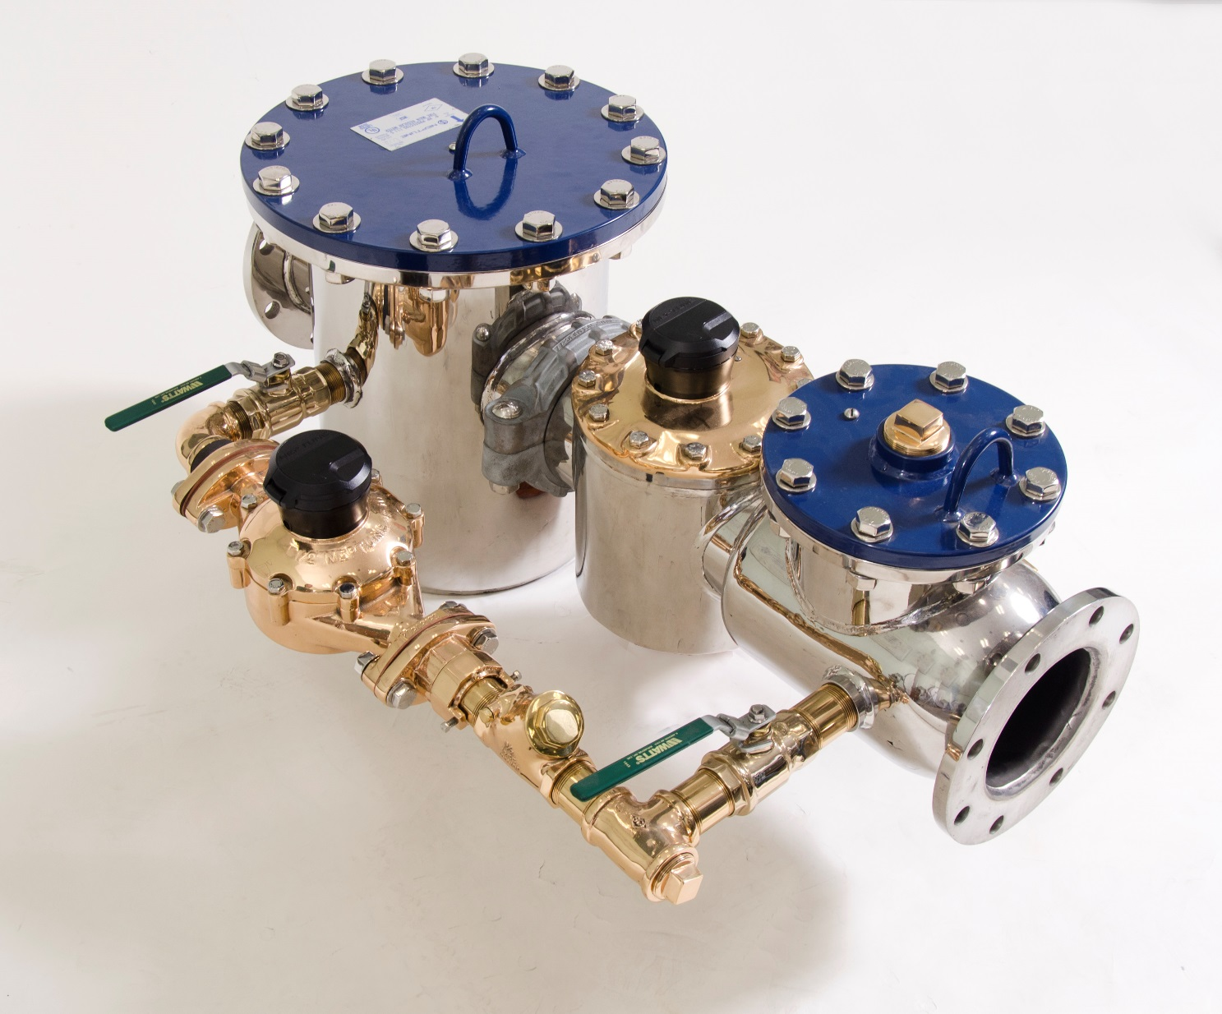
UL/FM Approved Strainer

Slide 42

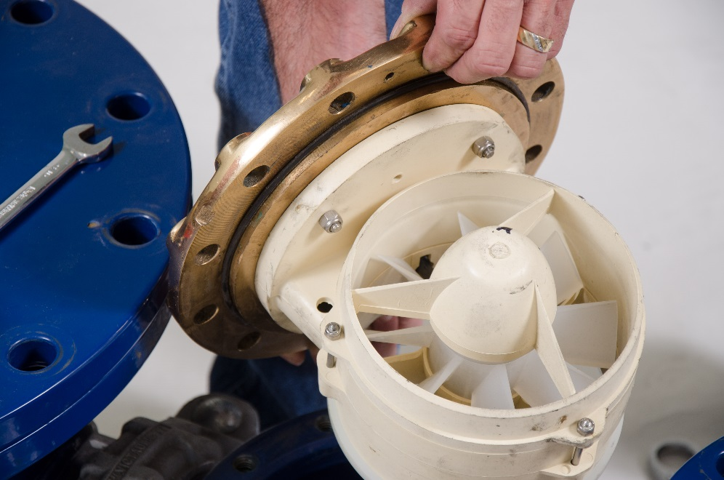
Utilizes HP Turbine
For medium and high flow through the unit

Slide 43
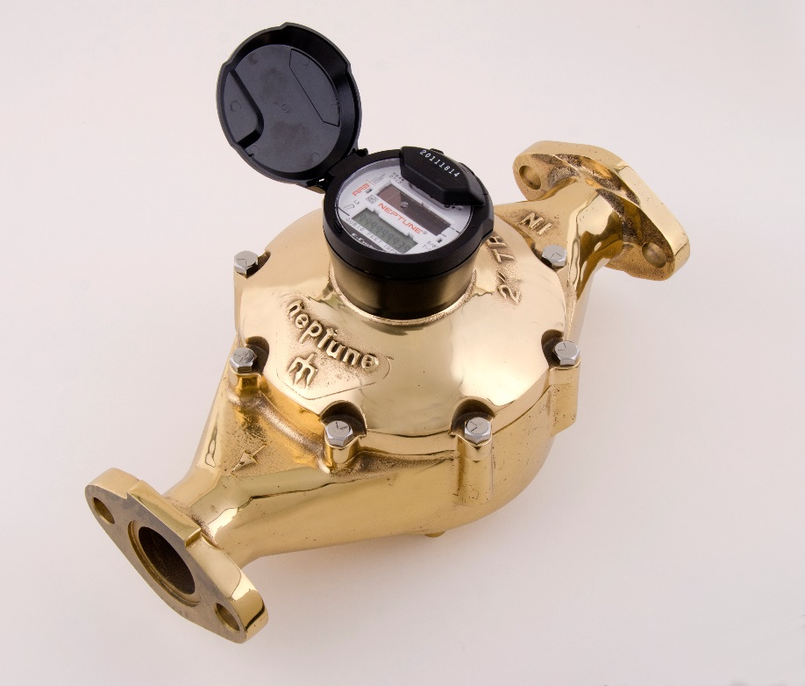
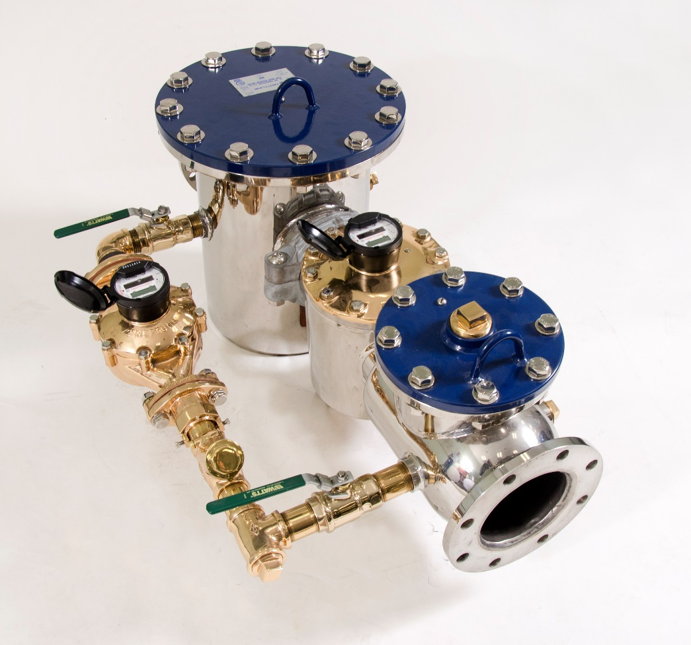
HP Protectus III Utilizes T-10
Bypass for low flows

Slide 44
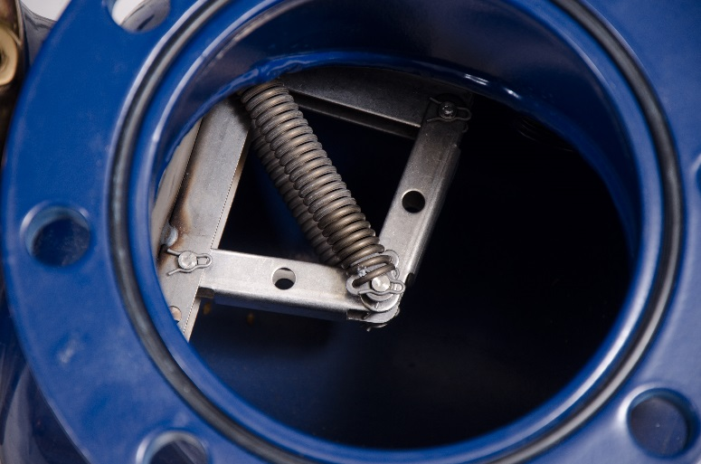
Knuckle Valve
Knuckle Valve is located behind HP Turbine
Diverts low flow to T-10® side

Slide 45
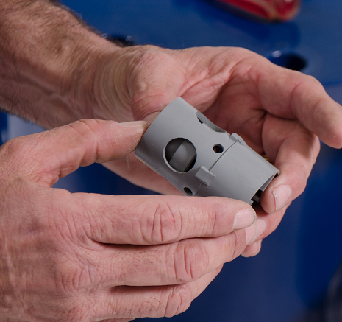
Throttle Valve
Throttle Valve is located in the outlet side of the T-10
Protects T-10 from over speed

Slide 46
Fire Hydrant
3” size
5 to 450 gpm
2” Gate Valve included
Aluminum Construction
No Lead Alloy Cover
NSF 372
Internal Strainer
UME - Factory Calibrated
Accuracy Calibration Vane
Lightweight, easy to handle
Locking register lid

Slide 47
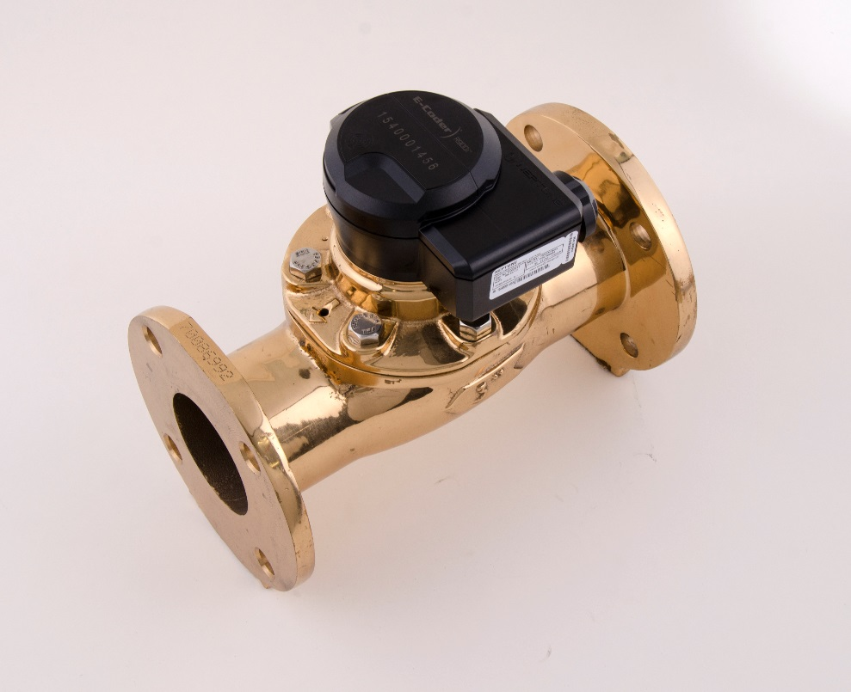
Moderate to High Flow Rates
Processing Plants
Manufacturing Facilities
Irrigation Lines
Lawn Sprinkler Systems
Wells
Effluent Water in Treatment Plants
Booster (Pump) Stations
Large Batching Operations
Inter-system sales or transfer
Office Buildings
Public Transportation Centers
  WHERE PEOPLE WORK!!

Slide 48
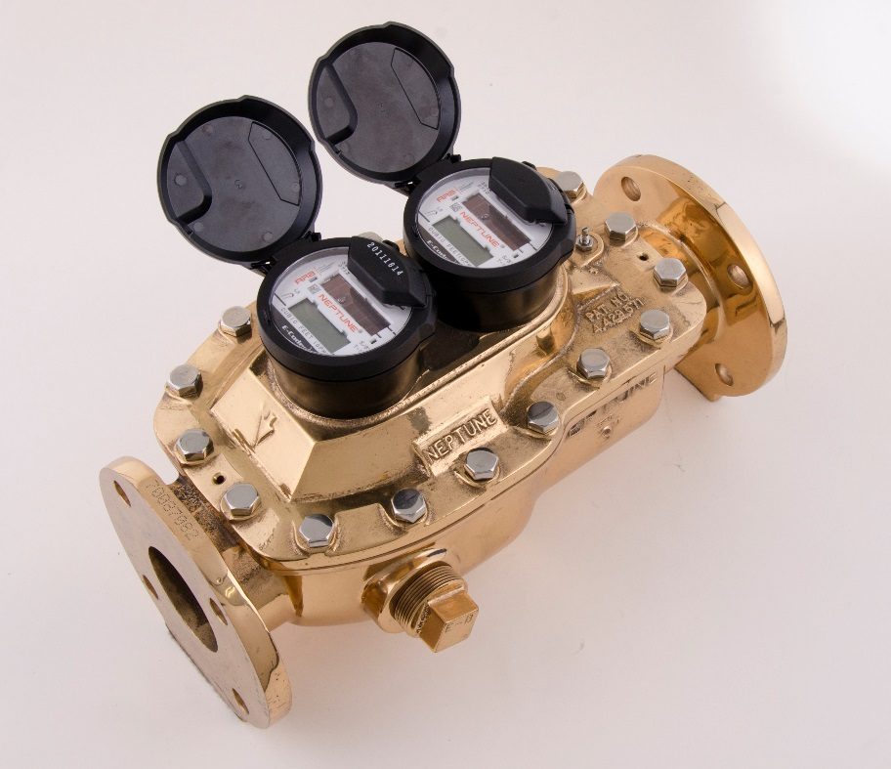
Low to High Continuous Flow Rates
Apartment Buildings
Motels and hotels
Condominiums
Mobile Home Parks
Hospitals and Schools
Restaurants
Dormitories
Department Stores
Shopping Malls
Public Transportation Centers
  WHERE PEOPLE LIVE!!

Slide 49
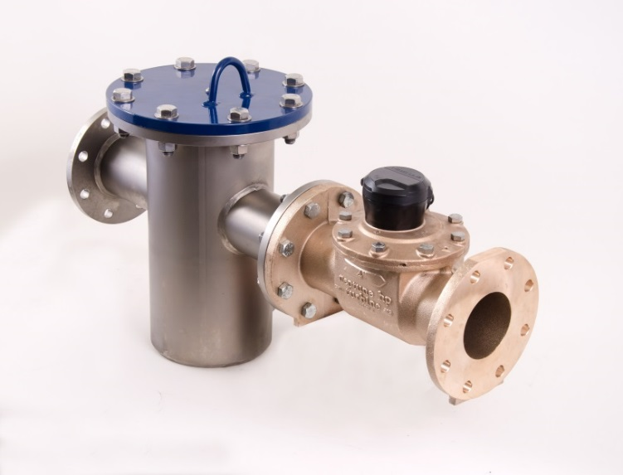
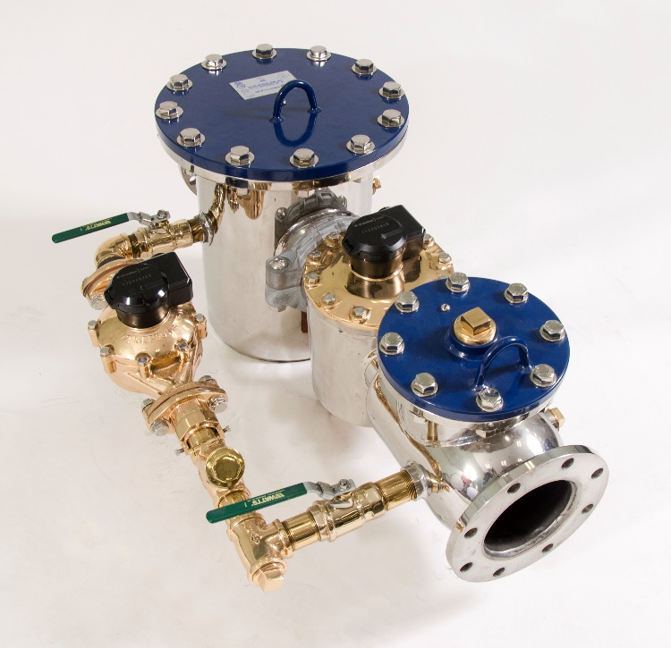
Fire Service Applications
Must be UL/FM Approved
Designated Fire Protection Lines
Any of the HP Turbine or TRU/FLO® meter applications that utilize the same service line to provide fire protection
  WHERE PEOPLE WORK AND LIVE!!

Slide 50
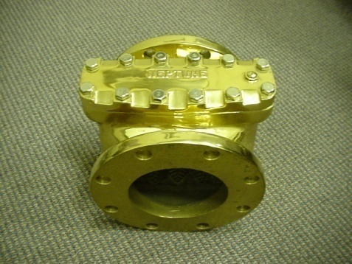
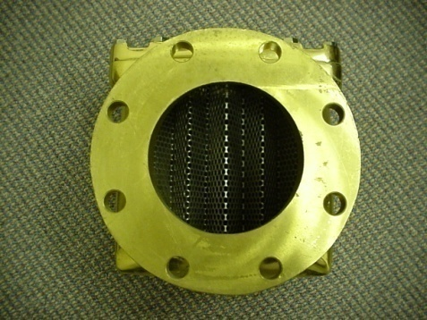
Important Note on Strainers
Use of strainer strongly recommended!
  Helps correct velocity profile
  Protects turbine from debris

Slide 51
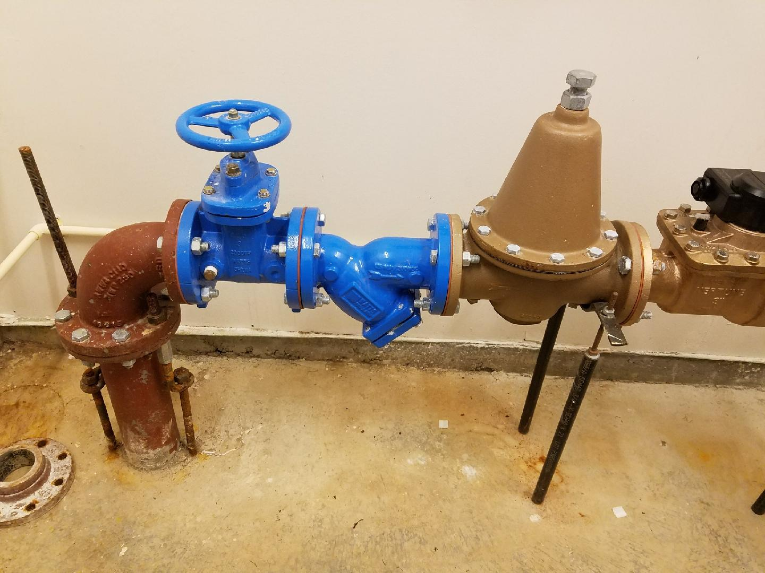
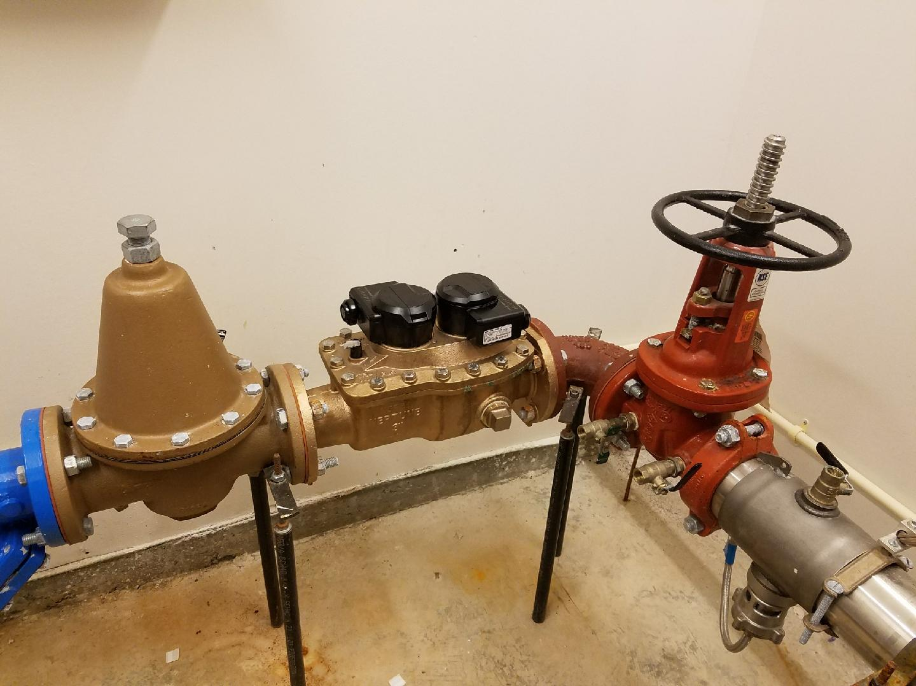
51
What Not To Do

Slide 52
Correct Sizing
Historical “Rule of Thumb”:
  Old sizing convention – 3” meter for 3” pipe
Actual Realization:
  Flow capacity not always dictated by pipe size
  More and more customers use low flow devices – e.g. ULF toilets = less consumption
  Building/facilities no longer used for original intentions
    (old processing plant converted to office space)
  Often consultants recommend larger meters due to future growth which never occurs

Slide 53

AWWA Sizing Guide
53
Developed in the 1980’s
Collected 5 years worth of data
Corrected sizing in many cases – ex. 2” PD on 6” Pipe
Correct sizing contributes in two major ways:
  Increased annual revenue
  Decreased annual capital expenditures

Slide 54
Reading Systems

Slide 56
Meter Reading Collection
AMR (automatic meter reading)
  Handheld
  Mobile
AMI (advanced metering infrastructure)
  Fixed Base Radio
  Cellular

Slide 57
Meter Register

Slide 58
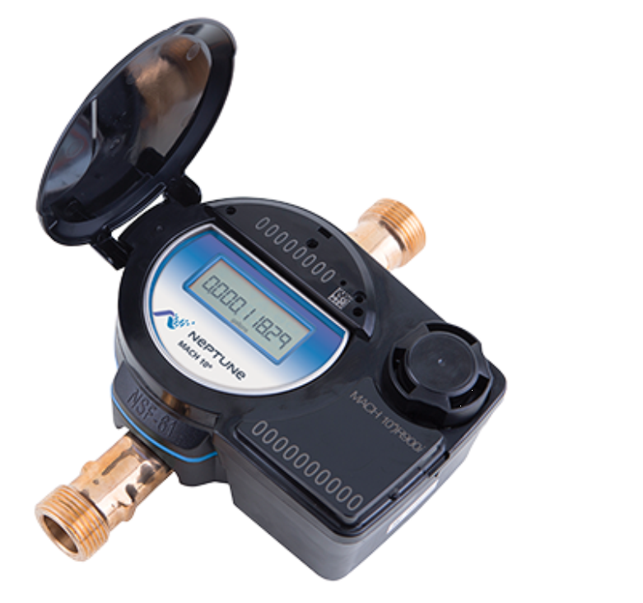
Meter Register
High Resolution Register
  With meter readings collected every 15 minutes, high resolution readings are key to creating usable consumption profiles.

Slide 59
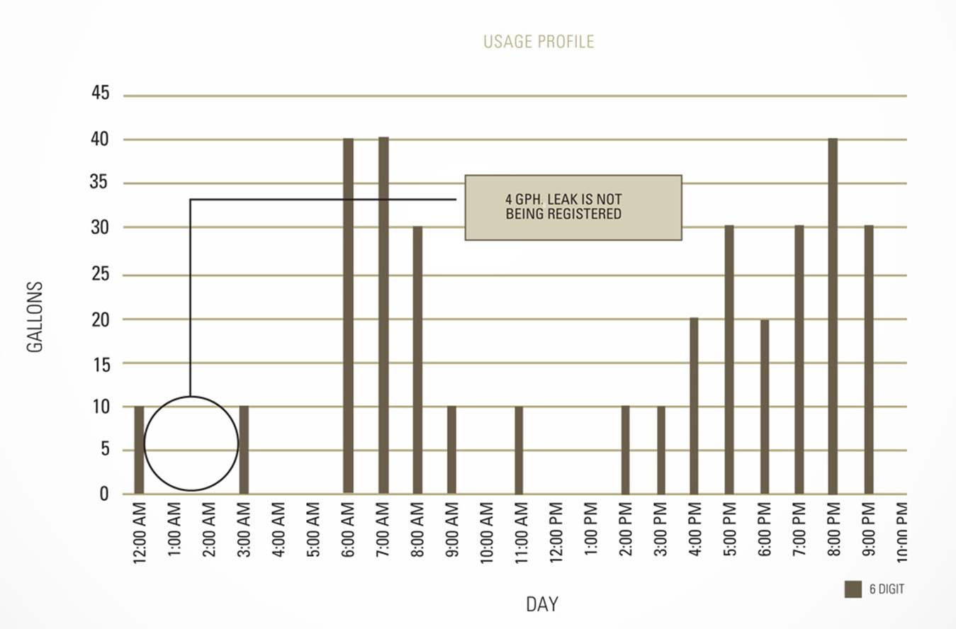
Low Resolution (6 digit) Meter Reading

Slide 60
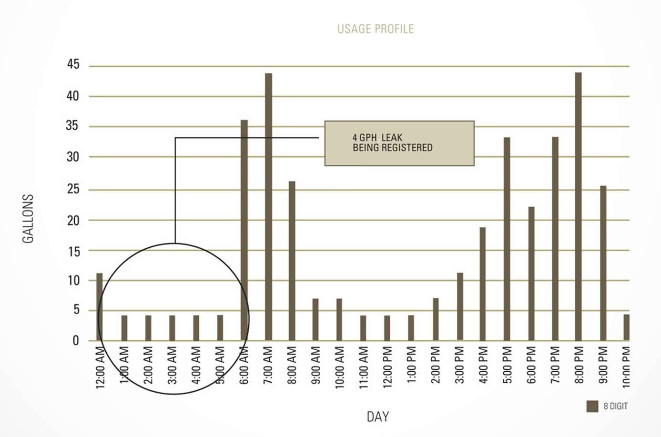
High Resolution (8 digit) Meter Reading

Slide 61
Radio Endpoint

Slide 62
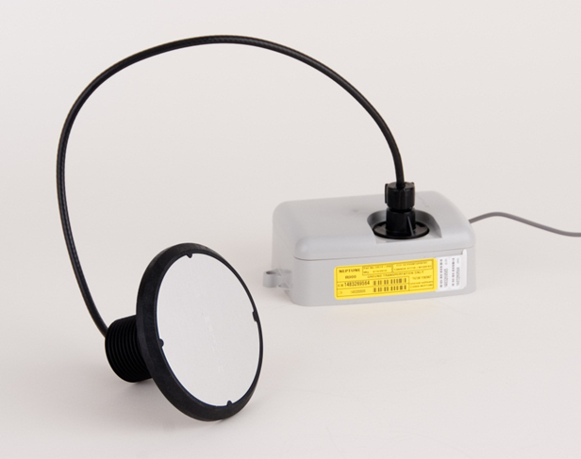
System Technology
Operational Efficiency
Unlicensed, One-Way (900 MHz) Frequency Hopping Spread Spectrum Transmitter
  No FCC license required
  Interference avoidance
  Battery life is dependable
High Output Power – FCC Part 15.247
  Read success rate is typically 99.5%
  Reduces reading time by as much as 40%
No Programming Required
  Ease of Installation and overall reduction in installation cost

Slide 63
Fixed Network Message Interleaved with Standard Mobile Messages
7 ½ Min
7 ½ Min
…
…
Low Power Mobile Transmission Every 14 Seconds

Slide 64

1 Watt – Fixed Network Transmission
Patented “3 Readings Packet”
  Flag data
  Current read
  Previous read (-15 minutes)
  12-hour read (- 12 hours)
Hourly data to the host

Slide 65
AMR
Automatic Meter Reading

Slide 66
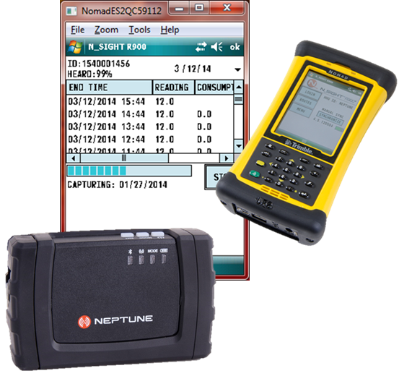
Handheld Meter Reading
Two piece design with Trimble Nomad and Belt Clip Transceiver.
Manual, Touch and Radio Read
Walk by and drive by
Belt Clip Transceiver can be paired with NGO App

Slide 67



Mobile Meter Reading
Mobile Transceiver paired with laptop
Most efficient mobile reading method optimizing reading distance and processing speed

Slide 68


NGO App
Available for iOS and Android devices
Bluetooth pairing with Belt Clip Transceiver
RF Test, Data Logging, Off Cycle and Pressure Monitoring

Slide 69

Data Logging
Ability to download 96 days of hourly readings
Address customer consumption concerns
Graph and report options
Field presentment

Slide 70

Mobile Meter Reading Software
Provides interface with utility billing system
Route Management
Reporting
Data Logging

Slide 71
AMI
Advanced Metering Infrastructure - Radio

Slide 72

Fixed Network AMI
Integrate New Technology Seamlessly
Reduced number of R900® Gateways facilitates AMI Migration
1 Watt Fixed Network transmission
Patented “3 Readings Packet”
  Flag data
  Current read
  Previous read (-15 minutes)
  12-hour read (-12 hours)
  Hourly data to the host

Slide 73

Migration
Simplify Operations
No programming required for AMI Migration
Fixed Network Message Interleaved with Standard mobile messages

Slide 74
AMI
Advanced Metering Infrastructure - Cellular

Slide 75

Cellular System Architecture

Slide 76
Implementation of Cellular System
Targeted Reading
  Commercial & Industrial
Fixed Base Backfill
  Ability to reach 100% reading without adding collectors
Full Implementation
  Municipal Utility
  Rural Water System

Slide 77
Benefits of Cellular System
NaaS (network as a service)
  Uses existing cellular network
  Eliminates cost of collectors and maintenance
Large Service Area Coverage
  Ability to reach 100% reading without adding collectors
Full Coverage
  Cellular network allows for complete coverage
Reading Frequency Options

Slide 78
Reading Frequency Options
Mode | Register Interrogation | Transmit Interval
Basic | 1 Hour | 24 Hours
Advanced | 1 Hour | 4 Hours
Pro | 15 Minutes | 1 Hour

Slide 79




Installation
Wired to encoded register
Wired to outside mount to maximize cellular coverage
  Will work inside based on cellular coverage
Activate unit
Verify transmission success

Slide 80
AMI
Head End Software
Meter Data Management Software

Slide 81
Meter Data Management Tools For:
Customer Service
Meter and Maintenance Staff
Finance
Conservation
Utility Management
Your Customers

Slide 82


Slide 83


Slide 84


Slide 85


Slide 86


Slide 87

System Health Screen
Collectors Down
Missed Reads
Found Meters
Invalid Readings

Slide 88

Leaks
Reverse Flow
High Usage
Inactive

Slide 89


Account View

Slide 90

Map View
Swipe to toggle
between Account
and Map View

Slide 91
Customer Portal

Slide 92


Slide 93


Slide 94


Slide 95
Thank you for
your time.

