Slide 1
North Dakota Backflow Prevention and Cross Connection Control Programs
Presented By: Jake Schafer

Slide 2

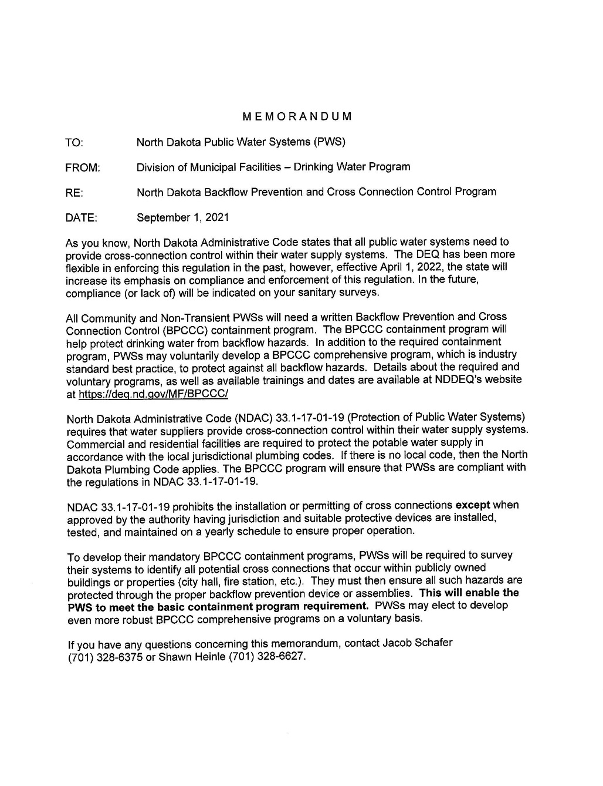



Backflow Prevention and Cross Connection Control Memorandum

Slide 3
Types of BPCCC Programs in North Dakota
Containment
Under the Containment Backflow Prevention and Cross Connection Control Program, public water systems will be required to survey the system and identify all potential cross connections that occur within publicly owned buildings or property (city hall, fire station, etc.) and ensure all such hazards are protected by means of the proper backflow prevention device or assembly. This program is required.
Comprehensive
Under the Comprehensive Backflow Prevention and Cross Connection Control Program, public water systems will be required to survey the system and identify all potential cross connections (car washes, restaurants, apartment buildings, etc.) and ensure all such hazards are protected by means of the proper backflow prevention device or assembly. This program is voluntary.

Slide 4
Containment Program
Only applies to publicly owned buildings or facilities. Essentially, locations that are not billed as independent customers within the water system.
City Hall, Fire Hall, Public Park, Community Center, City Shop, Water Treatment Plant, Etc.
Does not include: - County or State buildings/facilities that are owned by an entity other than that which owns the water system. - Public or private schools owned by an independent board (not the entity that owns the PWS). - Any commercial facilities that receive an individual water bill from the PWS.

Slide 5
Comprehensive Program
Applies to all public and commercial locations.
City Hall, Fire Hall, Schools, Daycares, Restaurants, Industrial Sites, Apartment Buildings, Shops, Etc.
Does not include: - Single family homes.

Slide 6
Comprehensive Program - Continued
Authority for public buildings and facilities comes from North Dakota Administrative Code 33.1-17-01-19
Authority for other locations (private businesses, etc.) must come from a city or community ordinance.
An example ordinance can be found at https://deq.nd.gov/mf/bpccc/

Slide 7
Backflow Prevention and Cross Connection Control Ordinance
BPCCC ordinances give communities and rural water systems the authority to implement and manage comprehensive BPCCC programs.
This Ordinance applies to all commercial, industrial and multi-family residential service connections within the public water system and to any persons outside the City who are, by contract or agreement with the public water system, users of the public water system. This Ordinance does not apply to single-family-residential service connections unless the public water system becomes aware of a cross connection at the single-family connection.
The public water system may collect fees for the administration of this program.

Slide 8
Containment or Comprehensive - Surveys
Both programs require elements of the public water system to be surveyed for cross connections/potential cross connections.
Survey forms can be found at https://deq.nd.gov/mf/bpccc/
Can be conducted by official of city/rural water system or by owner/resident.
Survey results will determine the need for cross connection control by means of backflow prevention device/assembly.
Surveyed locations and results do not need to be submitted yearly but should be retained for community records/sanitary surveys.
Surveyed locations and results can be kept and tracked on tab 2 of Appendix D – Annual Report/Tracking Spreadsheet

Slide 9

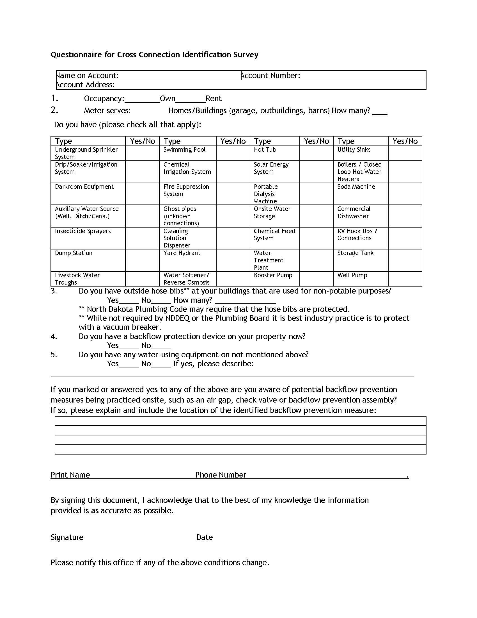
Survey

Slide 10
Backflow Prevention Devices/Assemblies
If you have determined a backflow prevention device/assembly is necessary at a surveyed location:
Determine which hazards are present (back pressure, back siphonage, pollutants, or contaminants).
Consult plumbing code and Appendix J table located at https://deq.nd.gov/mf/bpccc/ to determine the proper device/assembly for that location.
Have device/assembly installed in a timely manner to protect public water supply.
Devices and assemblies must be installed by a licensed plumber.
Standard timeline is 60 days from discovery, but alternative timelines may be approved at the discretion of the state (Supply chain issues, labor shortages, monetary concerns).

Slide 11
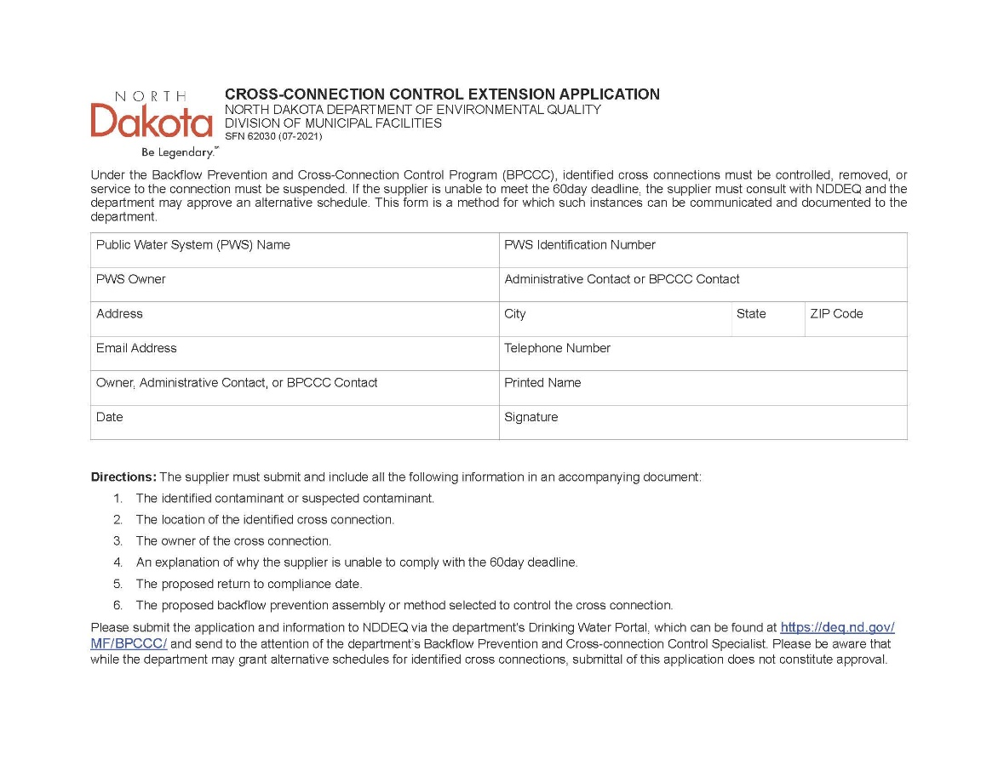
Alternative Timeline – Appendix C: Program Extension Application

Slide 12
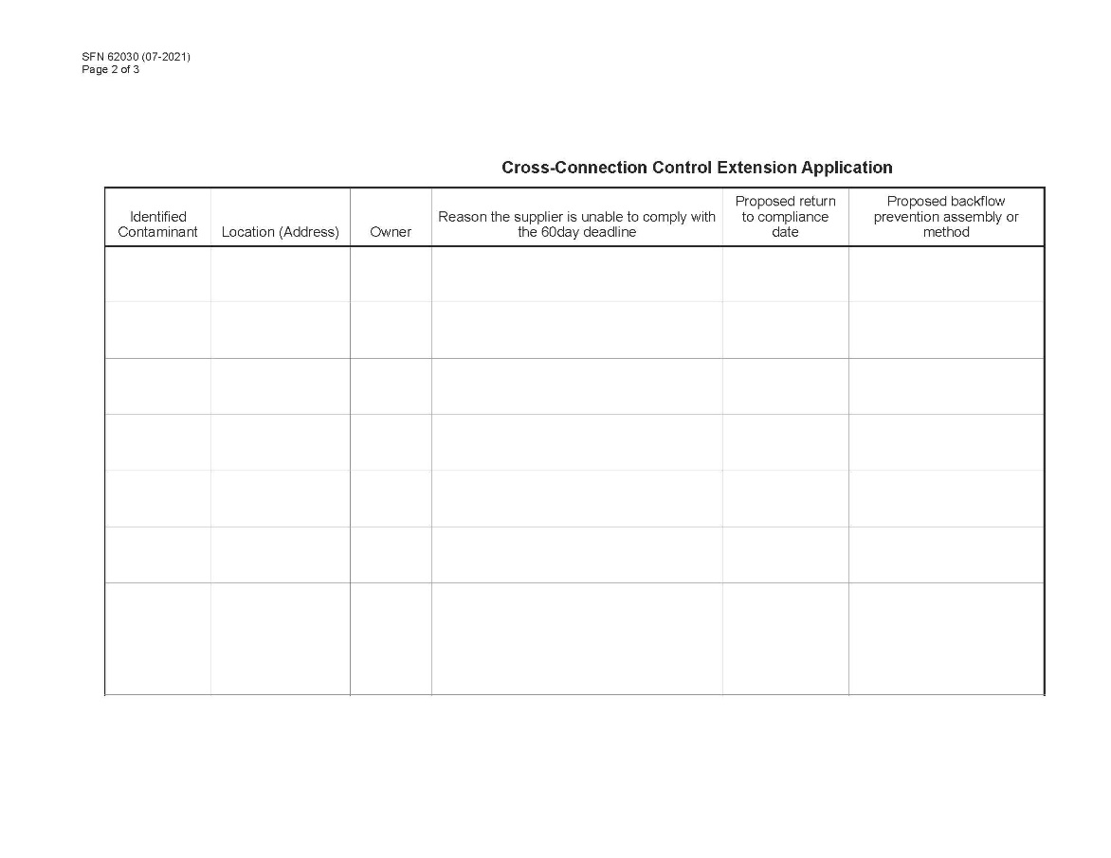
Alternative Timeline – Appendix C: Program Extension Application

Slide 13
BPCCC Program – Where To Start? Step 1
Go to the NDDEQ Backflow prevention website at https://deq.nd.gov/mf/bpccc/
Read the Guidance Document to familiarize yourself with cross connections, backflow, and the basics of a BPCCC program.
Read and begin to follow Appendix G: Implementation Steps
This will walk you through the entire process from start to finish.

Slide 14
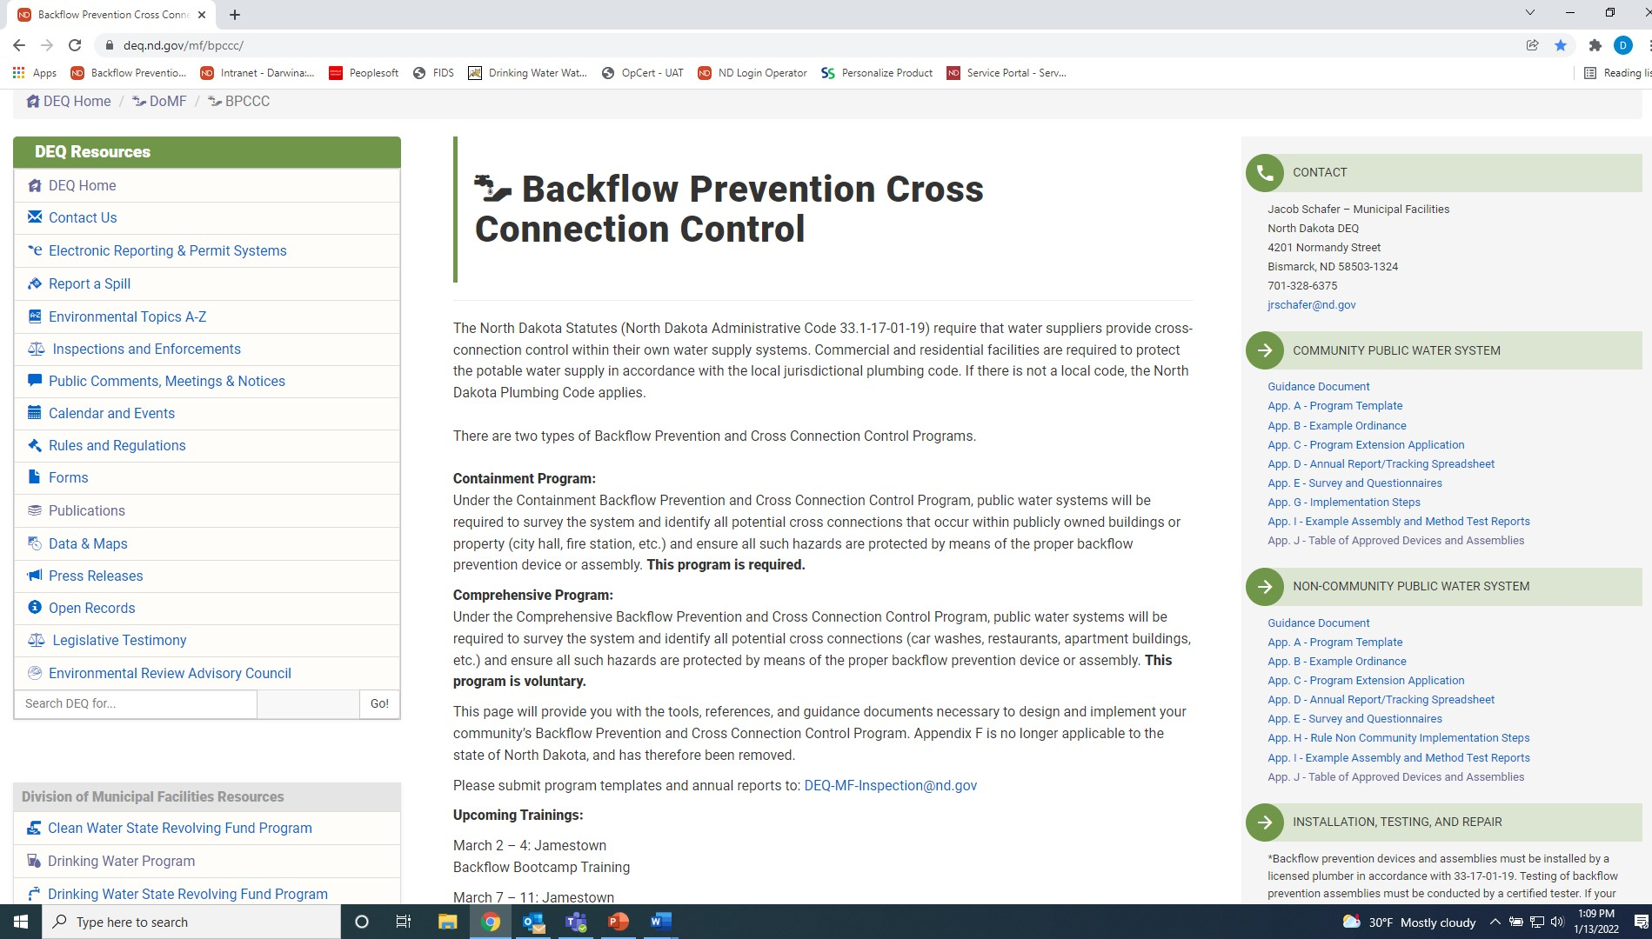

Slide 15
BPCCC Program – Where To Start? Step 2
PWS/City/Organization should decide which type of BPCCC plan they will implement.
Containment (bare minimum – required)
Comprehensive (voluntary)
Comprehensive plans will require adoption of an ordinance by city/organization
The system should notify any residents or stakeholders that will be impacted by program implementation.

Slide 16
BPCCC Program – Where To Start? Step 3
PWS/City/Organization should complete Appendix A: Program Template
Appendix A is your written Backflow Prevention and Cross Connection Control Plan
This indicates which type of program you are implementing, your contact for the program, your authority, the methods you will use, etc.
Appendix A should then be sent to NDDEQ
Due by April 1st, 2022 deadline mentioned in BPCCC Memorandum.
Email to: DEQ-MF-Inspection@nd.gov

Slide 17
BPCCC Program – Where To Start? Step 4
PWS/City/Organization must then conduct site surveys based upon type of program chosen.
Surveys conducted by system official or by mail.
Survey forms available on BPCCC website as Appendix E: Survey and Questionaires.
Other survey methods available such as Backflow Prevention Services Application.
Survey results should be used to complete Appendix D: Annual Report/Tracking Spreadsheet
Appendix D should be sent to NDDEQ
Due by April 1st, 2022 deadline and May 1st each year after.
Email to: DEQ-MF-Inspection@nd.gov

Slide 18
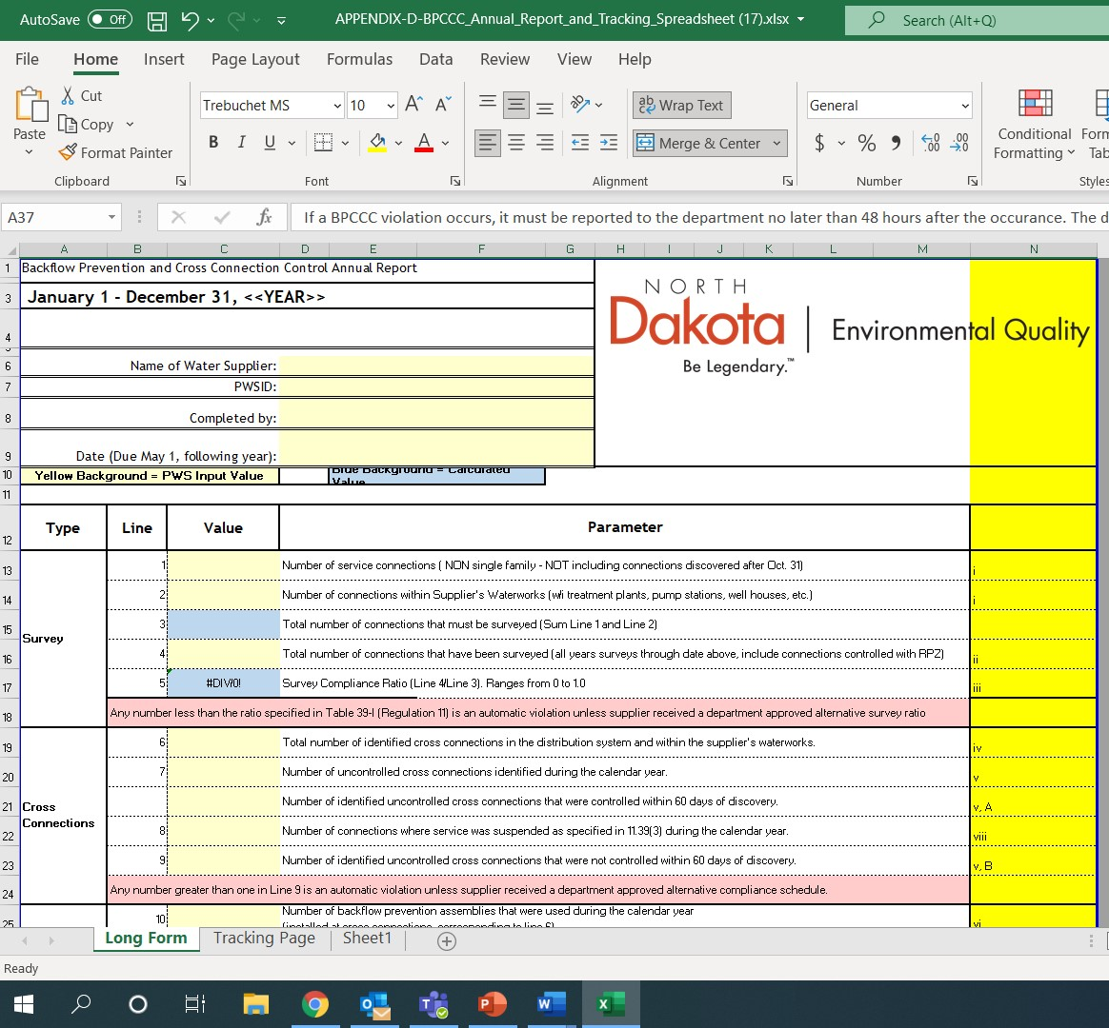
Appendix D – Annual Report/Tracking Spreadsheet

Slide 19
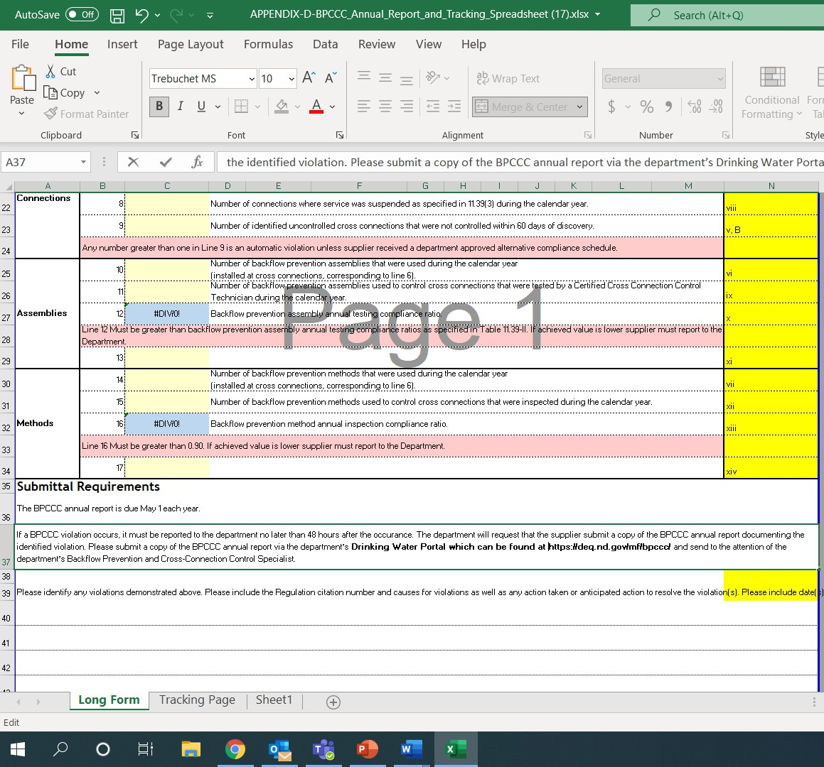
Appendix D – Annual Report/Tracking Spreadsheet

Slide 20
BPCCC Program – Where To Start? Step 5
Retain survey results for system records.
Appendix D: Annual Report/Tracking Spreadsheet tab 2 can be used for this.
Ensure installation of proper backflow prevention devices/assemblies where indicated by survey results.
If unable to be addressed within standard 60 day period, consider submitting Appendix C: Program Extension Application for additional time.

Slide 21
What comes next?
Ensure existing and newly-installed backflow prevention assemblies are tested yearly according to manufacturer specifications.
Testing and repair must be conducted by an individual certified to do so.
Must use an approved method and testing report.
Some approved method and test reports are available at https://deq.nd.gov/mf/bpccc/ Appendix I: Example Assembly and Method Test Reports
Retain testing records – may be reviewed during NDDEQ Sanitary Surveys

Slide 22
Training!
Upcoming Training Dates:
March 2-4: Jamestown, ND – Backflow Bootcamp
Bootcamp Trainings provide the basics of backflow prevention and plan development.
Register at backflowpreventionservices.com
March 7-11: Jamestown, ND – Tester Certification
Tester Certification trainings certify individuals to test and repair backflow prevention assemblies.
Register at backflowpreventionservices.com
Further training opportunities will be posted to https://deq.nd.gov/mf/bpccc/ as they are scheduled.
Small system operators (3300 and less) can take advantage of Operator Reimbursement for these trainings.
Backflow trainings count toward operator certification continuing education credits.

Slide 23
Questions?
For more information:
Jacob Schafer 701-328-6375 jrschafer@nd.gov

